Slide 1


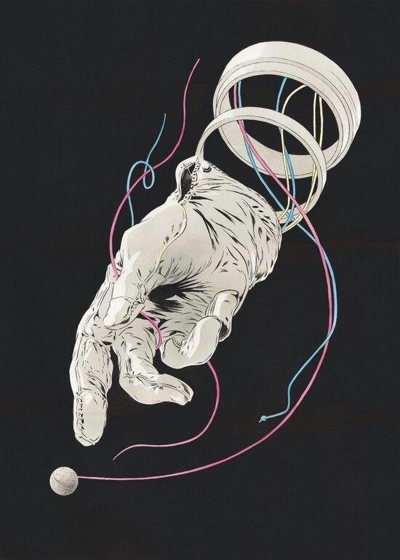
MACHINE LEARNING MINI PROJECT
CALORIE BURN PREDICTION
PRESENTED BY : ADITYA PHARSWAN
GUIDED BY : PROF. AMIT GUPTA

Slide 2
TABLE OF CONTENTS
INTRODUCTION
OBJECTIVE
DATASET
METHODOLOGY
MODEL
RESULT
CHALLENGES FACED
CONCLUSION
ACKNOWLEDGEMENT

Slide 3
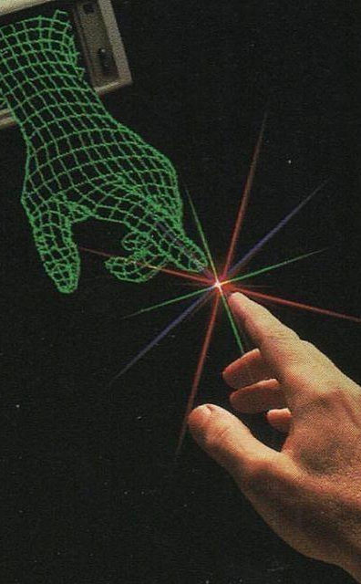
INTRODUCTION
In recent years, the integration of technology and health has transformed the way individuals monitor and improve their fitness levels.
This project focuses on developing a Calorie Prediction System using machine learning techniques to estimate the number of calories burned during physical activities.
By leveraging advanced algorithms, the system provides accurate and personalized insights based on user-specific parameters.

Slide 4
OBJECTIVE
The primary objective of this project is to design and implement a Calorie Prediction System using machine learning techniques that can accurately estimate calorie expenditure based on user inputs.
The project aims to achieve the following:
Promote Health Awareness
Leverage Machine Learning
Enable Data-Driven Fitness Decisions

Slide 5

DATASET
The dataset used for this project was sourced from Kaggle, a well-known platform for datasets and data science challenges. It consists of two primary component :
Calories Dataset : Contains information about the calories burned during various physical activities.
Exercise Dataset :
Includes user-specific and activity-related parameters such as:
Gender (male/female).
Age (in years).
Height (in cm) and Weight (in kg).
Exercise duration (in minutes).
Heart rate and body temperature during activities.

Slide 6
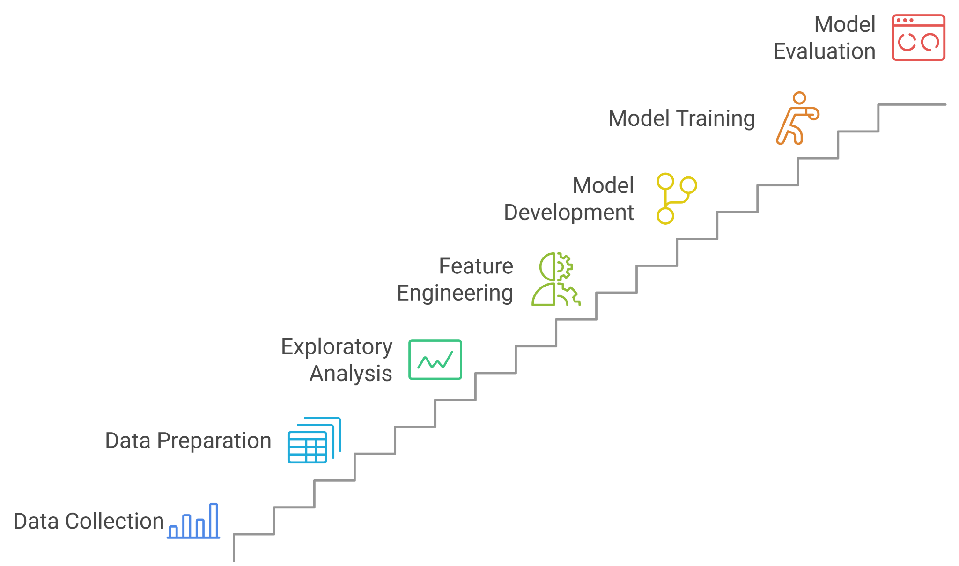
METHODOLOGY

Slide 7
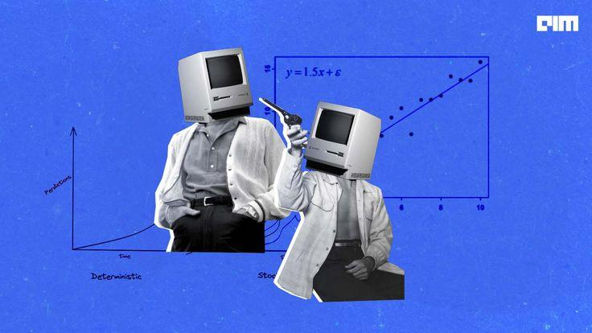
MODEL
XGBRegressor ,a powerful gradient boosting model used for regression tasks, especially when dealing with non-linear relationships and large datasets.
It is known for its high performance, speed, and accuracy, often outperforming other algorithms
The model offers several benefits, such as high accuracy, scalability, built-in regularization, and the ability to handle missing data.

Slide 8
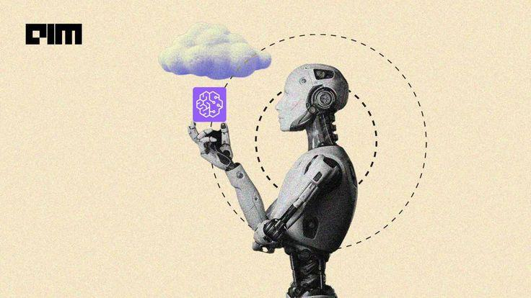
RESULT
Model Results Summary
Model Performance :
Mean Absolute Error (MAE) : 1.48 (lower value is better)
Sample Prediction :
Input: Gender = 0, Age = 41, Height = 175 cm, Weight = 85 kg, Duration = 25 min, Heart Rate = 100 bpm, Body Temp = 40.7°C.
Predicted Calories Burned : 142.48 (actual value = 143 )

Slide 9

CHALLENGES FACED
•Imbalanced dataset.
•Handling missing or inconsistent data.
•Deciding on the best model for the given dataset.

Slide 10

CONCLUSION
Learning Outcomes : Gained experience in data preprocessing, applying XGBRegressor for regression and evaluating model performance.
Future Application : Can be used in fitness apps for personalized calorie burn estimates and integrated into wearable devices for real-time tracking.

Slide 11
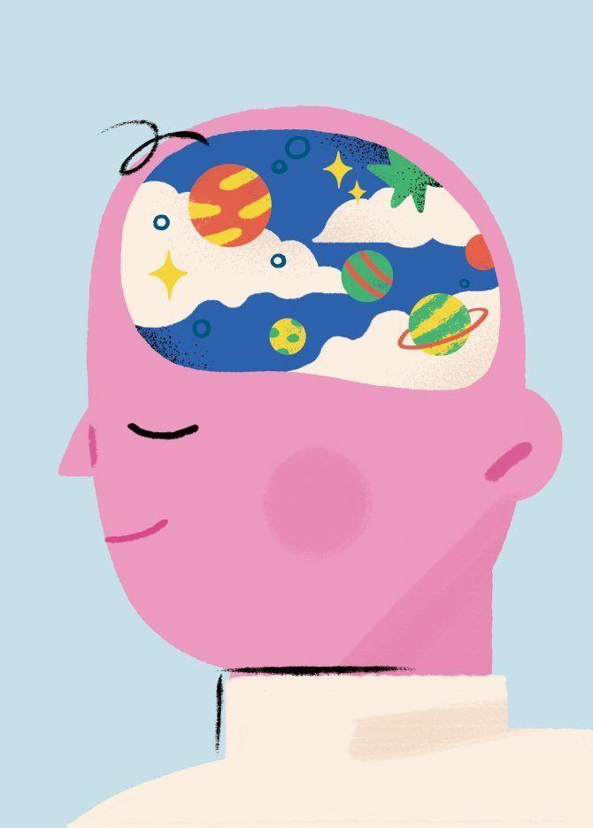
THANKS TO
MENTORS
Prof. Amit Gupta & Prof. Akash Chauhan
DATASET PROVIDER
Kaggle
REFERENCES :
Youtube(machine learning tutorials and python libraries basics)
IBM(Machine Learning using python)
GeeksforGeeks(Terminologies and information)

